Slide 1

Prediction of exact niche Using Bank Data
Using ML Algorithms
June
2019

Slide 2
Done by
Name:
Mariajohn Antony S
University:
Karunya Institute of Technology and Sciences
Year of Study:
3rd year
Name:
Pragadesh R
University:
Karunya Institute of Technology and Sciences
Year of Study:
4th year
Name:
Shivang sunil singh
University:
SRM university
Year of Study:
3rd year
2

Slide 3

Abstract
The data is related with direct marketing campaigns (phone calls) of SBI banking institution. The classification goal is to predict if the client will subscribe either any of the one ,they are Loan, Fixed deposit ,mutual funds, credit card etc.
3

Slide 4

Objective
The main objectives of the Bank are listed and prioritized in the Law: To maintain price stability; to support other objectives of the Government's economic policy, especially growth, employment, and reducing social gaps; and supporting the stability of the financial system.
4

Slide 5
Excisting System
Currently people go for informal sectors loan
and do know how much loan amount they can get from the bank and only the existing customer data is known by the bank
Basically, employee from the bank will be getting data from the IT company and call the customer for providing them loans
With the bank passbook and excisting loan details ,bank professionals will be deciding whether to give them loan or not
5

Slide 6
Proposed System
We are going to make computer to learn and make decisions whether to proceed
Further with these customer’s data
We are going to take the user’s datasets and from that we will be training the data with some machine learning algorithm
And we will analysizse the person like ,
6

Slide 7

ARCHITECTURE
1.Making data
2.Filtering Data
3.Total assets,libalities
4.Classification
5.% of loan preferable
6.Forwarding to maketting team
7

Slide 8
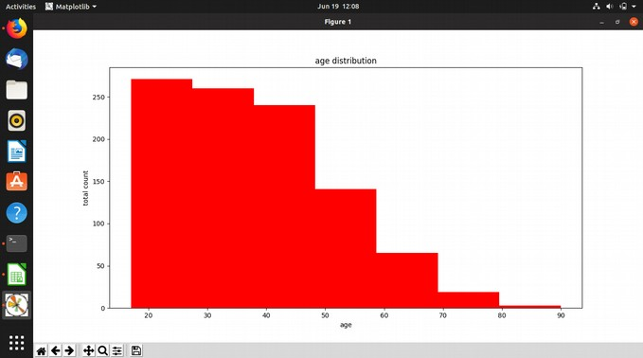
AGE CHART
Classification of people on the basis of their age.
8

Slide 9
Classification of the people on the basis of the age it is needed to done so that we can find the required work force where we need to concentrate or give much priority.Such as preferring the people of age between 30 to 45.

Slide 10
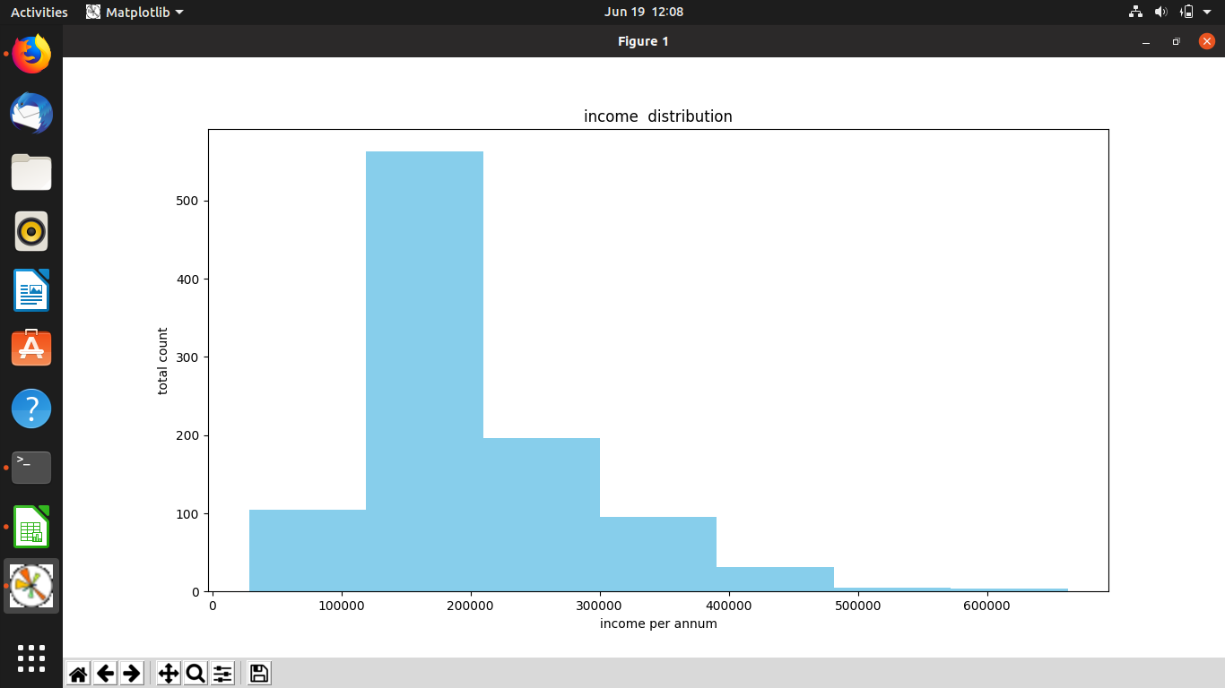
INCOME TABLE
Classify the people on the basis of their income.
10

Slide 11
Distributing the people on the basis of their income so that we can find the people who have the potential to pay the interest.Ioan can’t be given to a person until he shows the source of income.

Slide 12
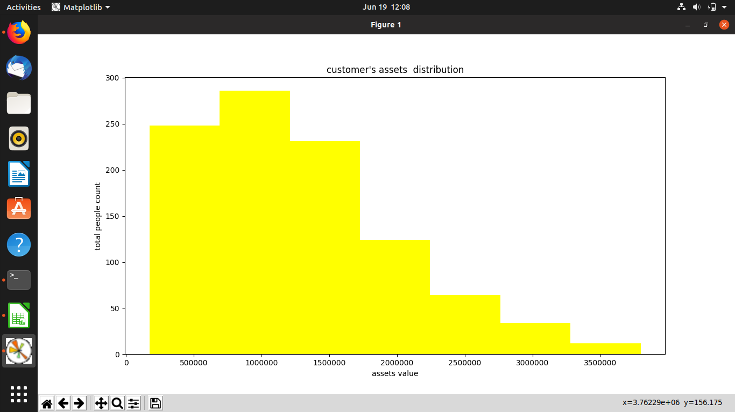
ASSET TABLE

Slide 13
If the person is unemployed still he can the loan or the credit reason is the asset value on the basis of asset value he can get a business loan bank has the security of his asset.

Slide 14
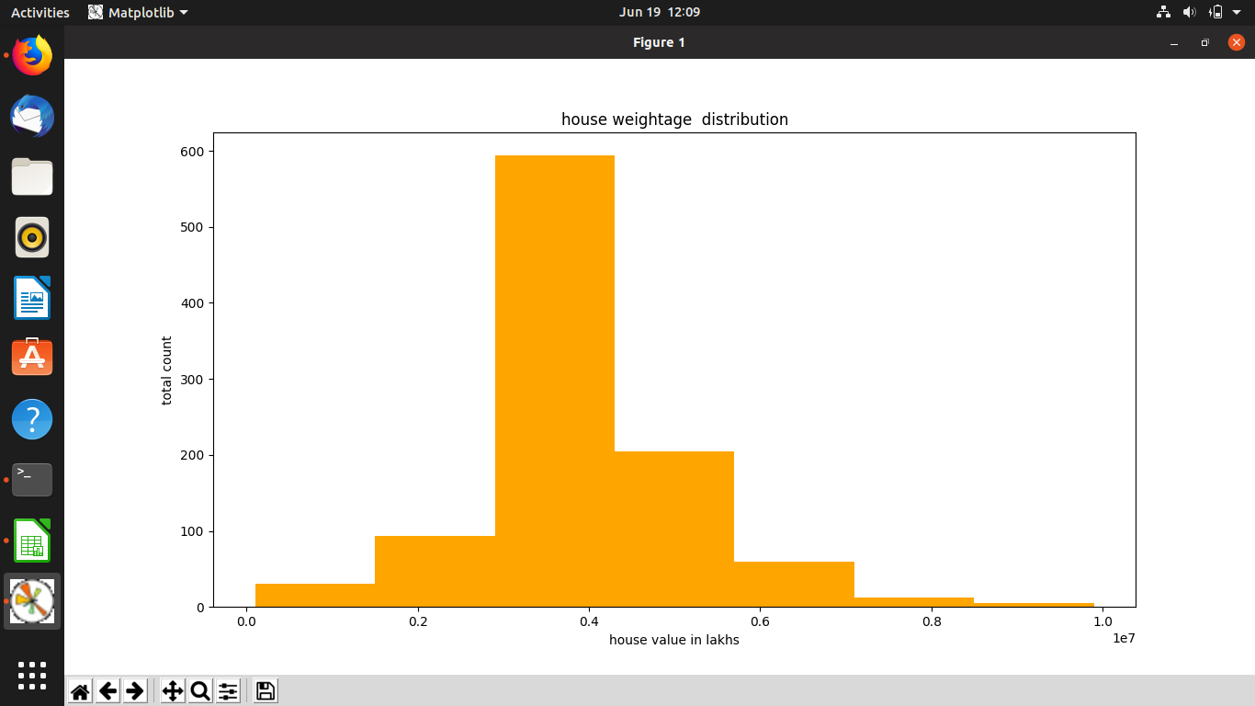
HOUSE VALUE

Slide 15
House is the main part of the asset which is a good security it also play a role in getting a good amount of credit because it is fixed and its value rerely decreases.

Slide 16
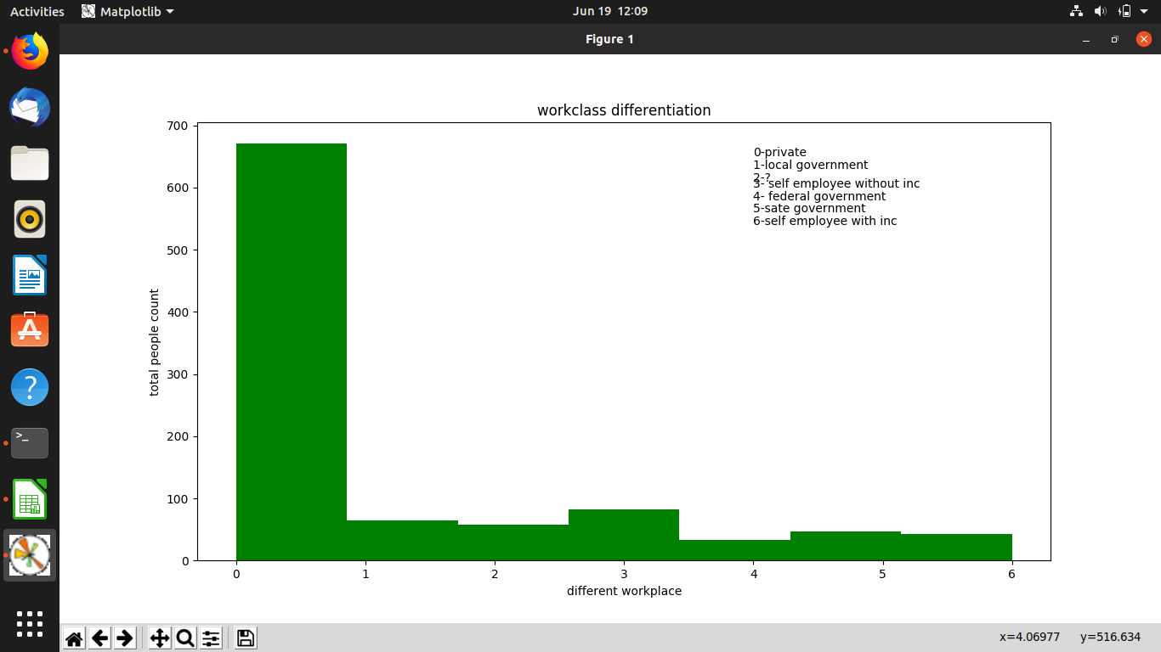
CLASSIFICATION ON THE BASIS OF THE WORK

Slide 17
People in india are mostly employed in informal sector or the private sector so they are not prefered on the above of government employ if a person is a long term employ then he is also elgible for a good amount of credit as compared to the government employ.

Slide 18
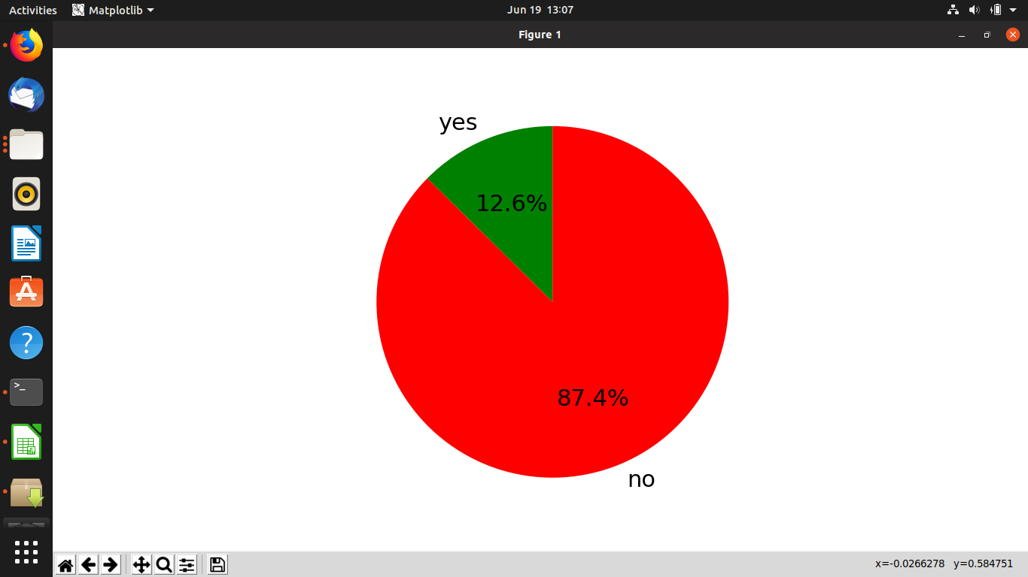
DO YOU HAVE A ROOF ????

Slide 19
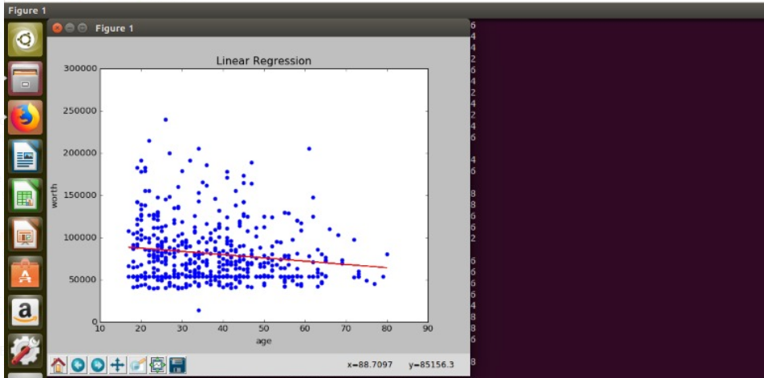
LINEAR REGRESSION DECISION

Slide 20
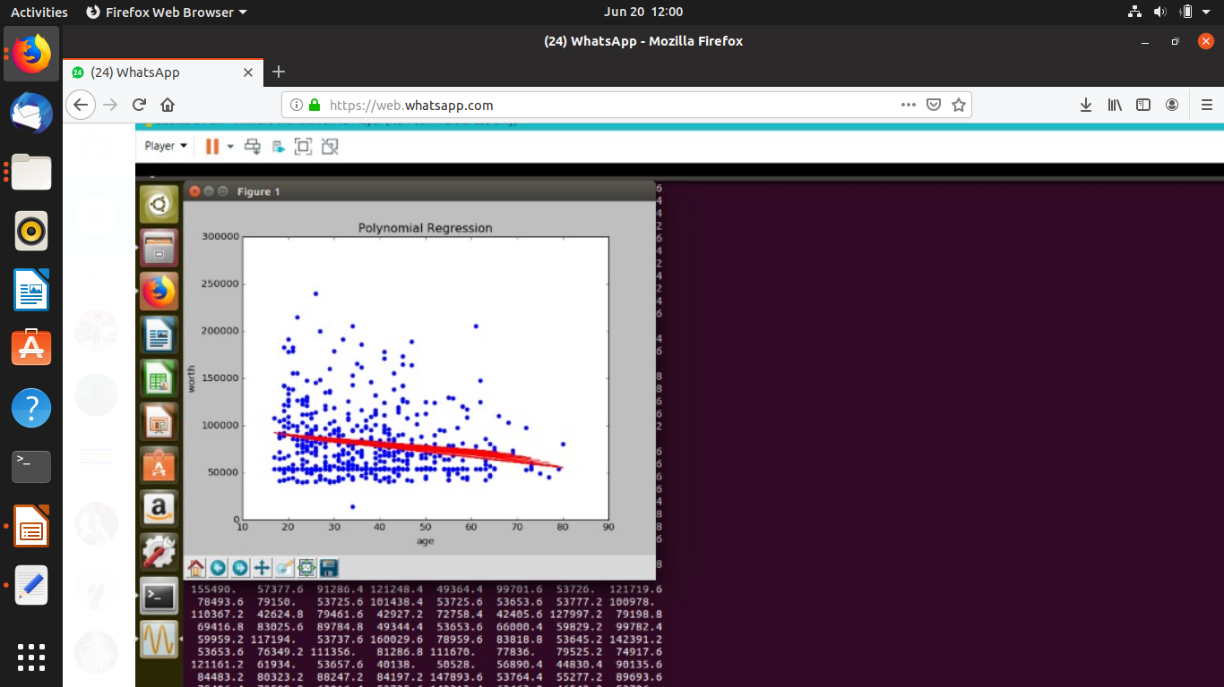
POLYNOMIAL REGRESSION

Slide 21
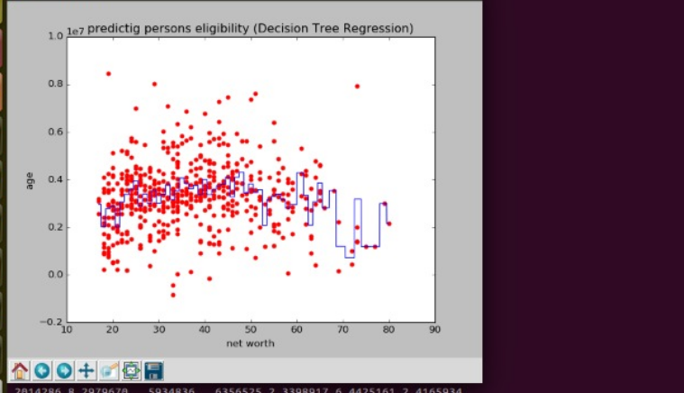
DECISION ON THE AGE

Slide 22
So we saw that one factor don’t affect a persons credit they are multiple and the population is billion so hear is the solution.

Slide 23
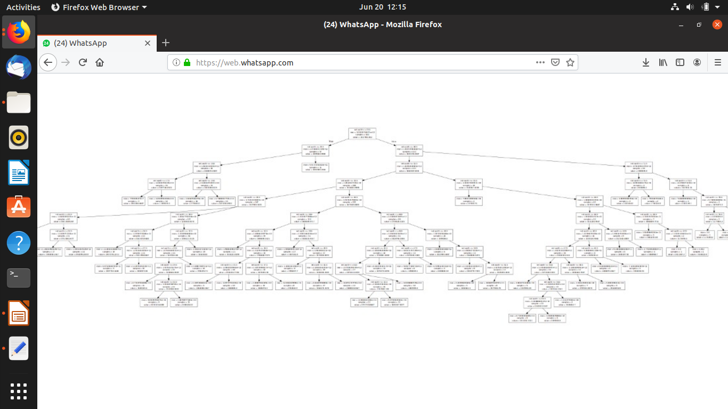

Slide 24

Have a Nice Day

